Slide 1

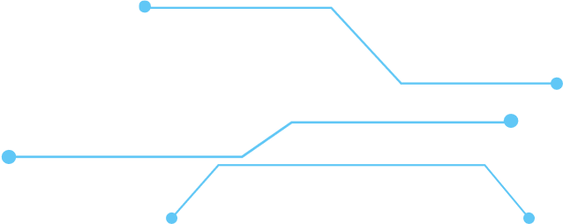
URL Shortener
Technologies: React, Node.js, PostgreSQL, Docker, Kubernetes, Prometheus, Grafana, GitHub Actions

Slide 2


Team Members
Ziad Ahmed Attia
Yasmeen Mohamed Talaat
Omar Samir Elmallah
Mohamed Sabry Abdelrahim
Project Supervisor
Eng. Mohammed Atta

Slide 3





The URL Shortener is a cloud-ready, scalable application that converts long URLs into short, shareable links.
The project demonstrates:
Full-Stack development
Containerization
Kubernetes deployment
Monitoring & observability
CI/CD automation
Problem Overview

Slide 4
Project Objectives

Slide 5
Add Prometheus
Automate deployment with
+ Grafana
Deploy to Kubernetes
GitHub Actions
Containerize the whole
system with
Docker
Use PostgreSQL for persistent storage
Develop a scalable
Node.js backend
Project Objectives
Build a simple
and intuitive
By building this system, we aimed to:
Create a full-stack
React frontend
URL shortening service

Slide 6
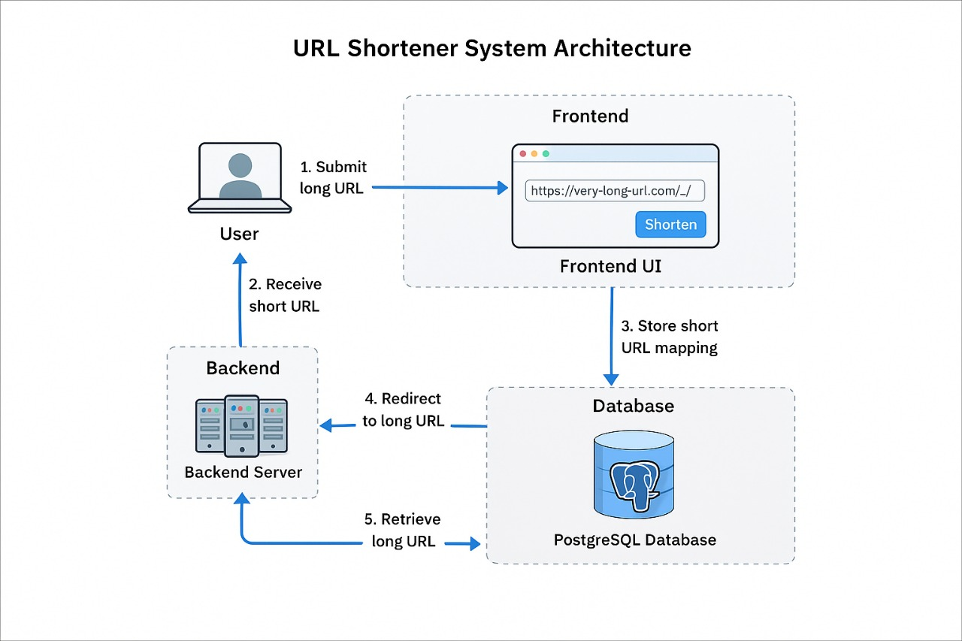
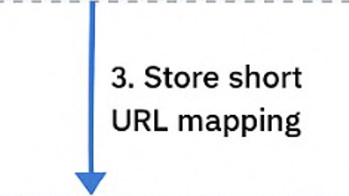

System Architecture

Slide 7
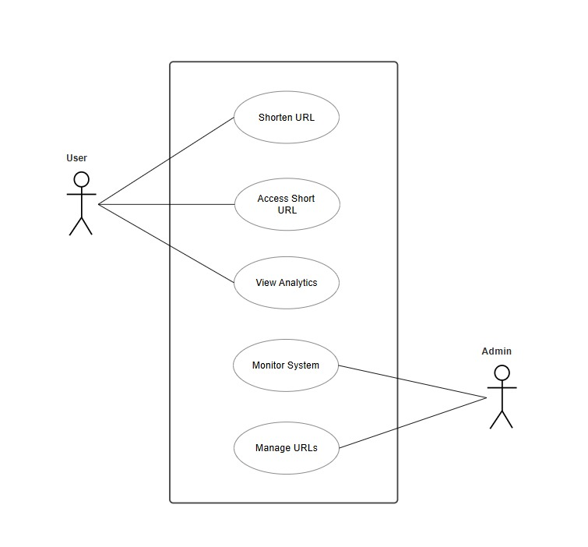
Use Case Diagram

Slide 8
Fronted (React)
Monitoring
Built with React
Clean UI for short link creation
Shows analytics (visits count)
Prometheus: Metrics exporter
Grafana: Dashboard for system health
System Components
CI/CD
Backend (Node.js)
Automated build and test
Auto-deploy to cluster
URL creation
URL redirection
URL analytics
RESTful API architecture

Slide 9

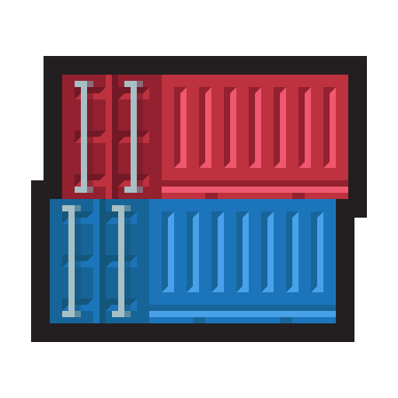

Containerization Strategy
Remote Area Residents
Build Stage
Result
Compile TypeScript
Install dependencies
Build React App
Copy Artifacts only
Alpine Linux base
90% smaller images
Docker
80MB fronted, 200MB backend

Slide 10
Network Isolation
Docker Compose
Each service runs inside its own isolated network for better security.
Service Dependencies
Example: Backend starts only after the database is ready.
Health Checks
Ensures containers are healthy before receiving traffic.
Persistent Volumes
02
Stores data outside containers → Zero data loss on restart.
01
03
04

Slide 11




K8s Deployment
The application is deployed on a fully container-orchestrated environment using Kubernetes to ensure scalability, reliability, and seamless updates.

Slide 12
Multi Component Deployment
Frontend, backend, PostgreSQL, and monitoring each run as separate Deployments.

Slide 13
Service Discovery
ClusterIP for internal communication — NodePort for external access.

Slide 14
Persistent Storage
PostgreSQL uses PV + PVC to ensure durable data across restarts.

Slide 15
Self Healing &
Rolling Updates
Automatic pod restarts and zero-downtime updates through Kubernetes controllers.

Slide 16
Monitoring & Observability
01
Prometheus
Collects key application metrics :
URLs shortened (total)
Successful redirects
Failed lookups (404 errors)
Requests per second (RPS)
95th percentile request latency (via histogram buckets)
Prometheus scrapes the backend every 5 seconds using the /metrics endpoint.
02
Grafana
Visualizes dashboards for:
API performance
Redirect success rate
Error rate (404 lookups)
Total shortened URLs
Request latency (95th percentile)

Slide 17
GitHub Actions Automations:
Build Docker images for backend & frontend
Push images to Docker Hub with versioned tags (latest + commit SHA)
Trigger Kubernetes deployment after successful build
Update image tags automatically in manifests
Apply changes to the cluster using kubectl
Ensure deployments roll out successfully
Ensures:
Fast and automated deployments
Zero-downtime updates using Kubernetes rolling updates
Consistent and reliable release cycles
No manual intervention needed in CI/CD
CI/CD Pipeline

Slide 18
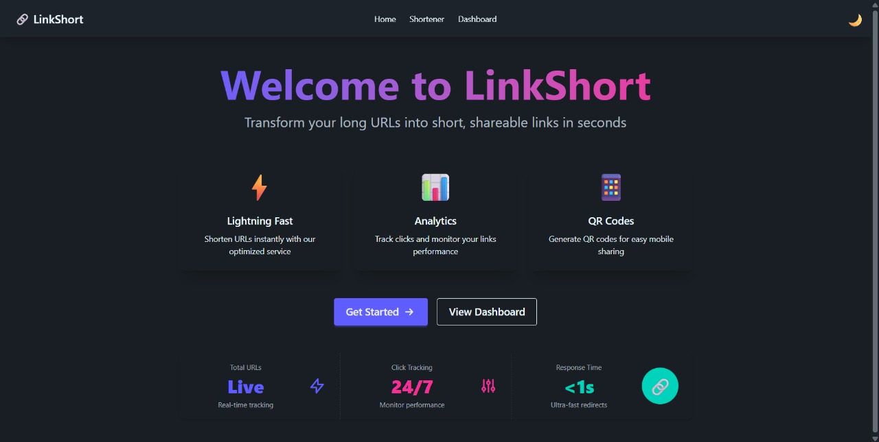
Url Shortener

Slide 19
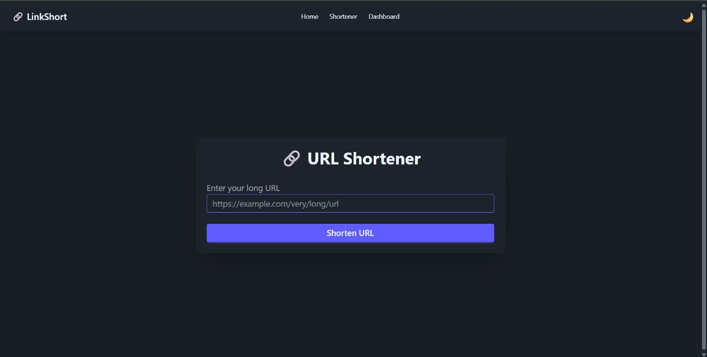
Url Shortener

Slide 20
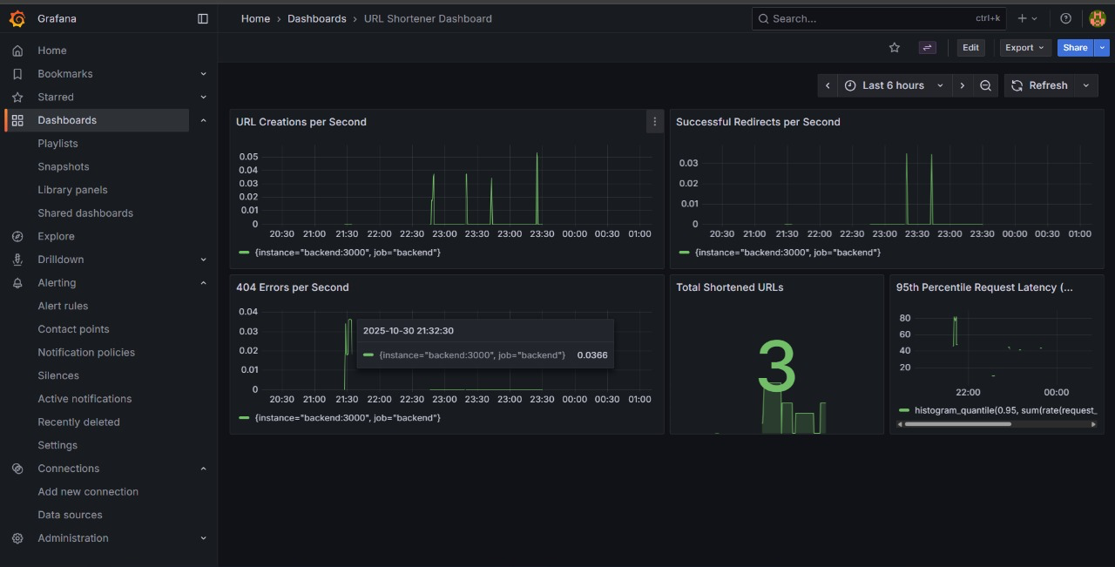
Dashboard

Slide 21
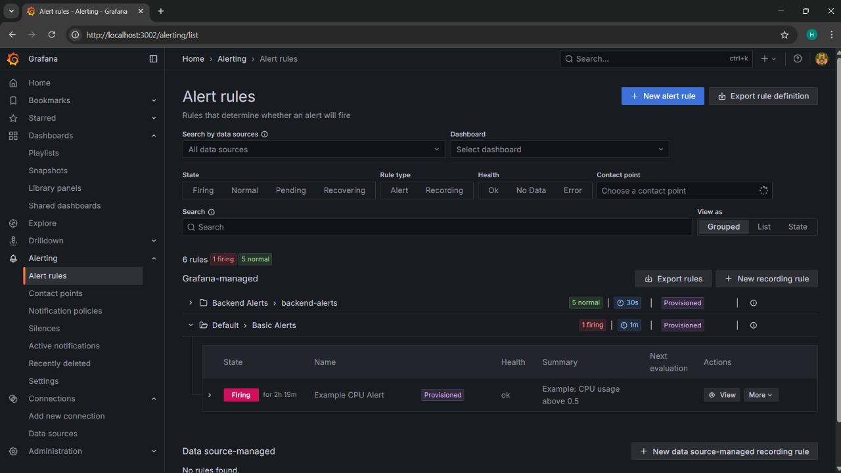
Alert

Slide 22
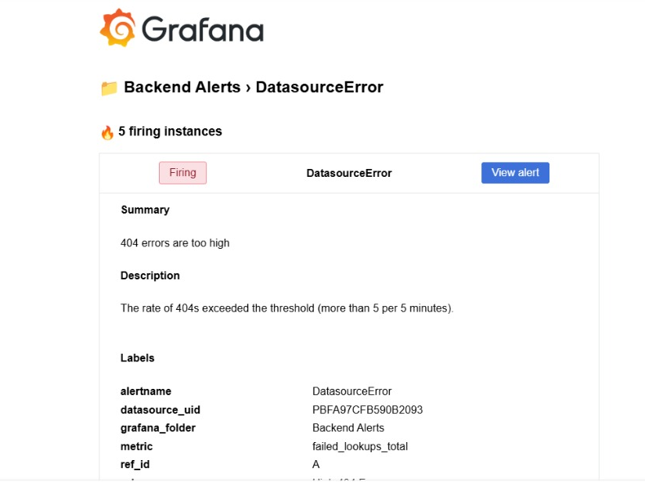
Alert

Slide 23
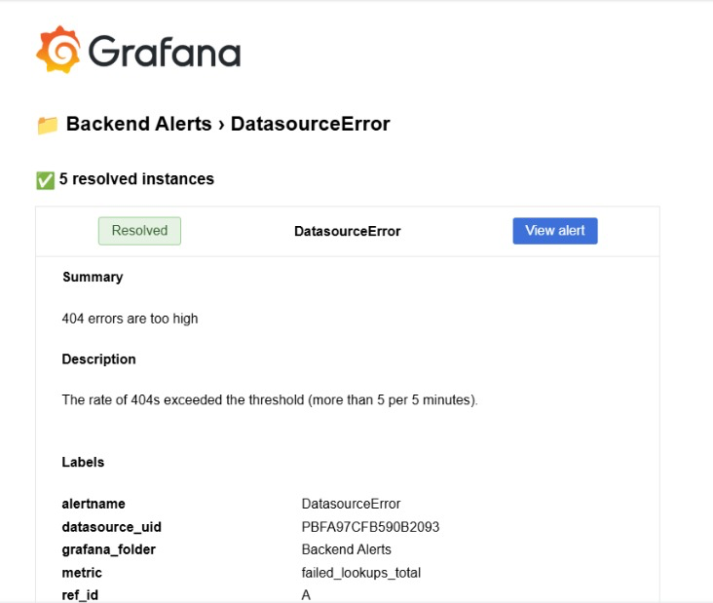
Alert

Slide 24
Thank You

